Slide 1
PVT Manager 1.4.0
Release info
2014-10-07

Slide 2
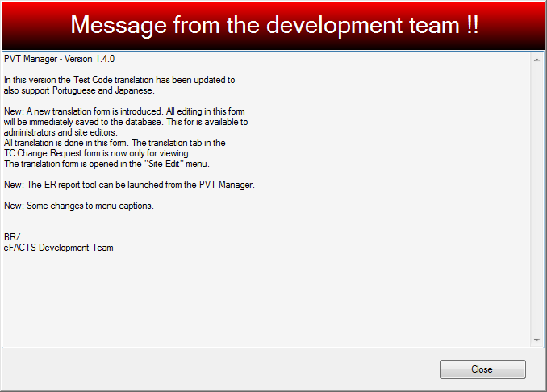

Slide 3
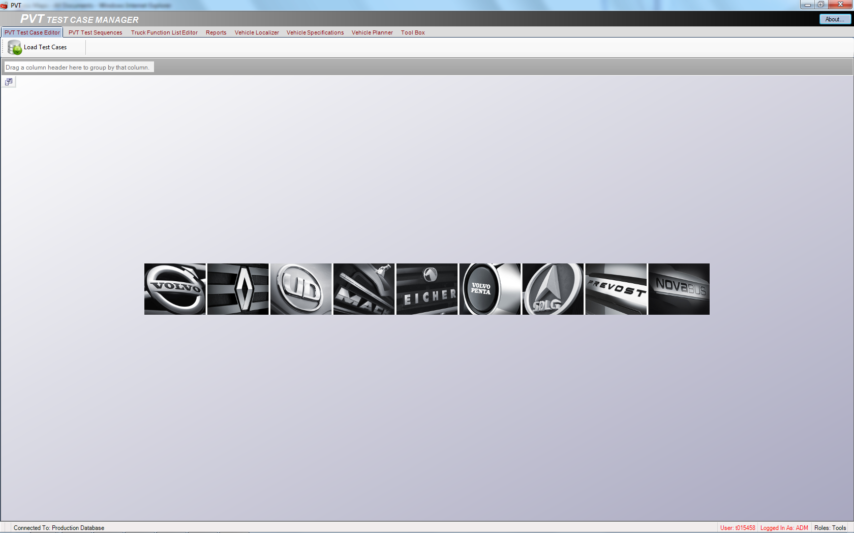
Less icons when you start and new icon style

Slide 4
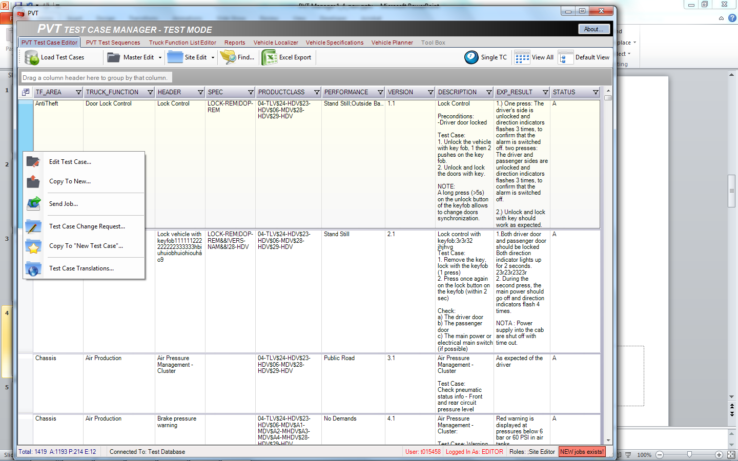
Select TC and right click to get action options

Slide 5
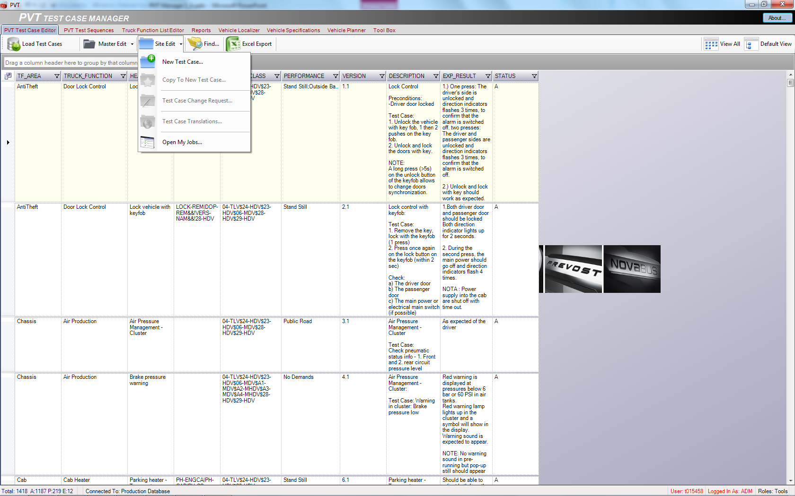
Master and Site editor menu changed
Possible to copy old test case (but a test case have to be selected first)
When test case is copied, the local translations, PROTUS points and PROTUS text are not included

Slide 6
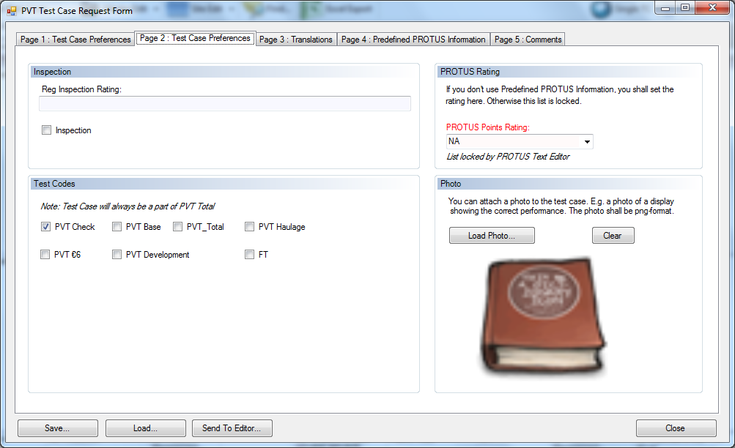
If copying TC some mandatory fields will be empty

Slide 7
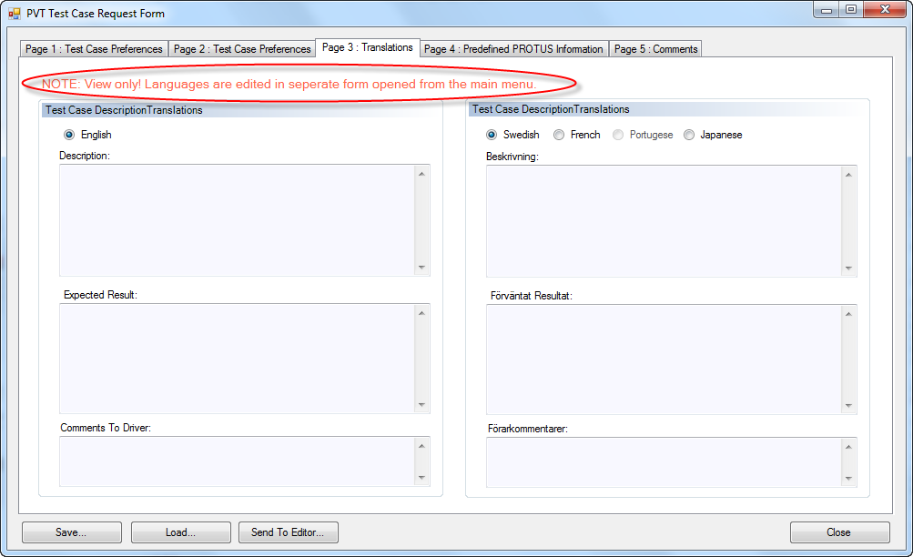
Only English is possible to edit in the Test Case Request Form

Slide 8
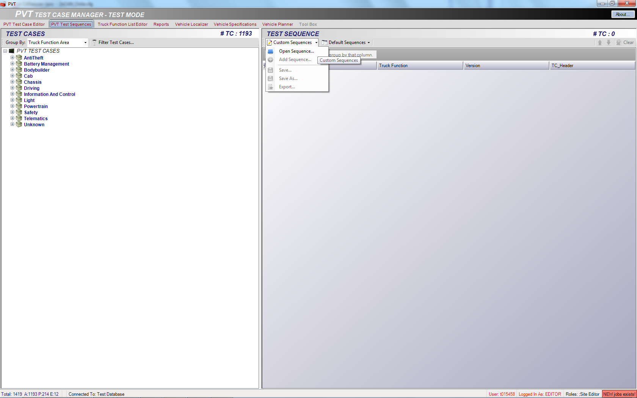
Site Editor can now create own sequences
Contact Master Editor, to get guideline for this

Slide 9
New work flow - PVT Test Case Process
Approve Remark
Truck Function Specialist
Approve
Remark
Update PVT Manager
Remark
TC Released
Translation Done
Master Editor
2
Approve Remark
Remark
Approve² Remark
Local Site Editor
Review
Translate
Test Leader or Site Editor
Change or New Test Case
Change Req
New
1 Performance Validation Test
Change of Status of Job inside PVT Manager
2 If TC is sent by Site Editor, the TC is sent directly to Master Editor

Slide 10
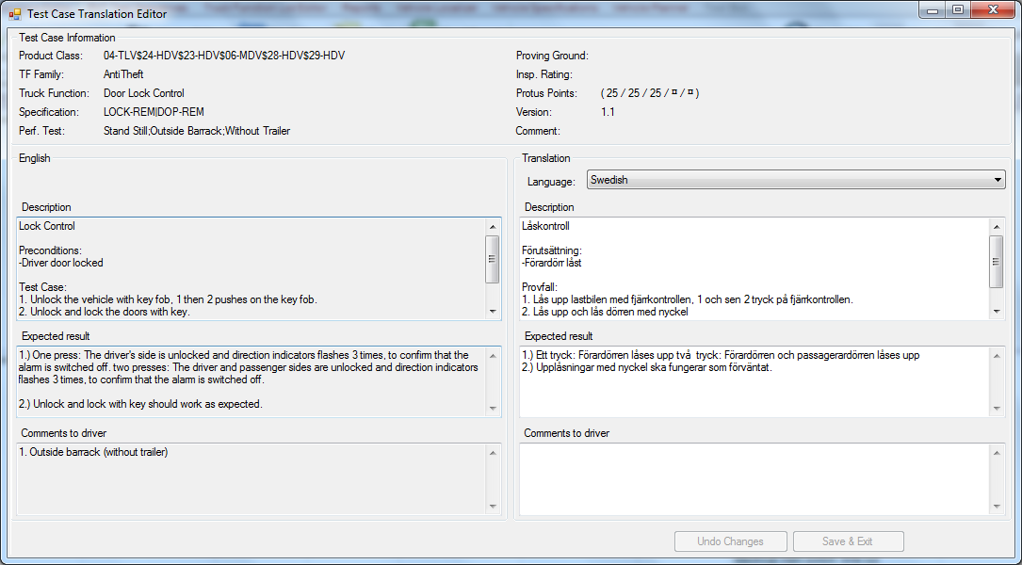
Default translation language will be according to user site setting.
Site editor responsible for correct translation. It should be identical as the English text.

Slide 11
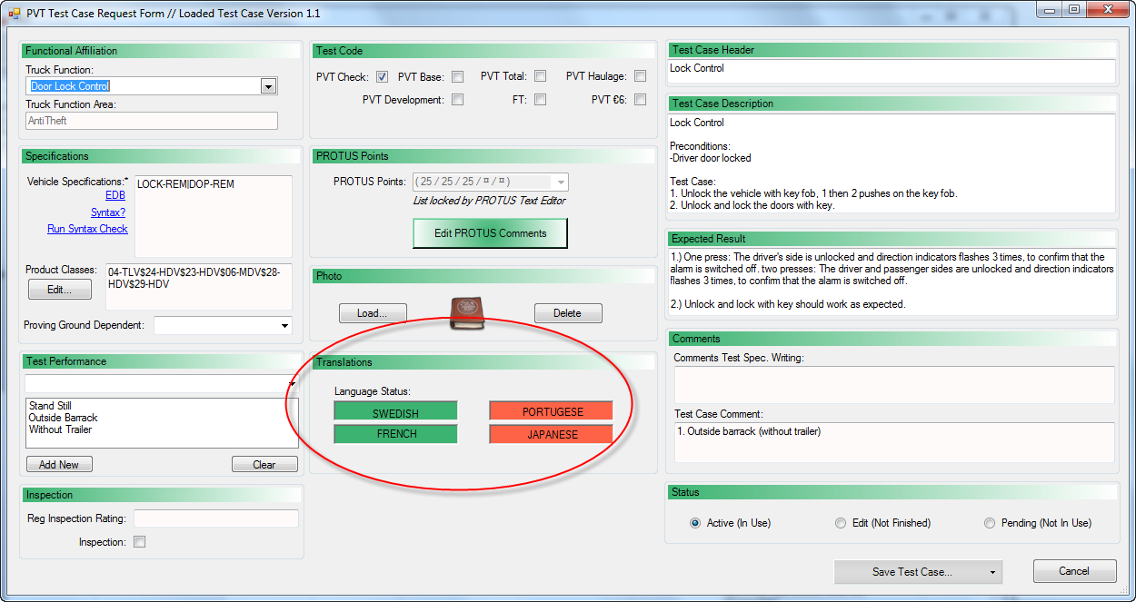
Master Editor view – will indicate if translation done for local language.

